Slide 1

PARSE
NEVER MISS A DETAIL.
GROUP T2501 · BİLKENT UNIVERSITY · CS 491 / 492 · SPRING 2026

Slide 2
01 — THE PROBLEM
Built for attending.
A 90-minute lecture. Dozens of dense slides. Most of it lost the moment the call ends.
01
02
03
04
Information Overload
Accessibility Barriers
Engagement Gaps
Platform Fragmentation
Difficulty capturing and retaining key information across long, dense presentations. Notes can't keep up.
Hearing-impaired participants lack reliable real-time transcription. Captioning is inconsistent or absent.
Joining late or missing a section means losing the thread. Recordings get archived, never re-watched.
Zoom, LiveKit, and meeting tools live in silos. Each one requires its own assistant, its own workflow.
1 / 13 PARSE

Slide 3
02 — OUR ANSWER
PARSE doesn't just transcribe.
It listens to the meeting, watches the slides, and answers questions grounded in both.
LISTEN
WATCH
ANSWER
Real-Time Transcription
Patch-Level Slide Vision
Grounded Q&A
Deepgram Nova 3 streams every spoken sentence under 3 seconds, fanned out via WebSocket to the desktop companion.
DocLayout-YOLO splits each visual data into typed patches; OpenCLIP and bge-m3 embed them for semantic retrieval.
Qwen3.5-VL generates context-aware answers in natural language with citations back to the exact slides used.
Deepgram Nova 3 · <3s latency
DocLayout-YOLO · OpenCLIP · bge-m3
Qwen3.5-VL · pgvector · with citations
What makes PARSE different
SELF-HOSTED
MULTI-PLATFORM
PRIVACY-FIRST
VECTOR SEARCH
OPEN-SOURCE STACK
2 / 13 PARSE

Slide 4
03 — TECHNICAL ARCHITECTURE
System Architecture
Six microservices, one coherent data path.
USER SURFACE
Web Dashboard
Desktop Companion
Zoom Sidebar
↗
EXTERNAL SERVICES
Next.js 16 · React
Electron · macOS
React 18 · Zoom Apps
Recall.ai
Meeting bot orchestration
Deepgram Nova 3
API GATEWAY
Backend Service
Bot Service
Real-time transcription
Zoom RTMS
FastAPI :8001 · Auth + JWT
FastAPI :8002 · WS fan-out
Desk-share + webhooks
⚡
INTELLIGENCE
GPU Server · FastAPI :8000
KEY OPTIMIZATION
DocLayout YOLO · OpenCLIP · Qwen3.5-VL · Deepgram Nova 3
Perceptual Hashing
Slide-change detection runs before GPU inference. Identical frames are skipped — the GPU only fires on real transitions.
DATA
PostgreSQL + pgvector
Redis
768-dim embeddings
session cache · job queue
Docker · CUDA · WebRTC
3 / 13 PARSE

Slide 5
04 — HOW IT WORKS
From Slide to Answer
An AI pipeline that fuses speech and slides — answers grounded in the deck.
1
2
3
4
5
6
7
Slide
DocLayout
Speech-to
Open
Vector
Qwen3.5
Grounded
Input
YOLO
Text
CLIP
Store
VL
Answer
frame capture
patch detection
Deepgram Nova 3
embeddings
pgvector
VLM inference
with citations
01
02
03
Visual Understanding
Semantic Search
Grounded Answers
DocLayout-YOLO analyzes each slide to detect text, formulas, diagrams, and tables in real-time.
OpenCLIP and bge-m3 create embeddings for visual and text content — pgvector retrieves the patches that matter.
Qwen2.5-VL generates context-aware answers with citations back to the specific slides they came from.
4 / 13 PARSE

Slide 6
05 — PROJECT TIMELINE
Plan to Production
ALL MILESTONES MET
CS 491 · FALL 2025
CS 492 · SPRING 2026
Sep
Oct
Nov
Dec
Jan
Feb
Mar
Apr
May
M1 · Project setup
M2 · Auth + room CRUD
M3 · Live media (Recall.ai)
M4 · Transcription (Deepgram)
M5 · Slide ingest pipeline
M6 · Vision-language Q&A
M7 · Zoom integration
M8 · Desktop companion
M10 · Performance + VRAM tune
Test sprint
M9 · Documentation & Report
Capstone fair + demo
5 / 13 PARSE

Slide 7

06 — PROMO VIDEO
See It
One real meeting. One real question. End-to-end in seconds.
6 / 13 PARSE

Slide 8
07 — THE BIGGER MARKET
Beyond Education.
Same problem at 100× scale. Every business runs meetings — and AI is already in them.
$3.5 B
$21–34 B
100 K+
69%
global AI meeting assistant market in 2025
projected by 2033
organizations on AWS Bedrock
enterprise share of category
Cluster of estimates from MarketsandMarkets, Grand View, MRF.
25–26% CAGR across major analyst forecasts.
Largest enterprise GenAI platform — and our partner conversation.
Largest customer segment (Data Bridge, 2024).
WHERE PARSE WINS
STRATEGIC IMPLICATION
Slide-grounded, not just transcript-grounded.
Same architecture. Same value. Different buyer.
Otter, Fireflies, Fathom
Transcribe & summarize — text only.
Microsoft Copilot, Zoom AI
Native to one platform — locked in.
PARSE
Fuses live audio with patch-level slide vision — answers cite exact slides.
Education proves the model. Enterprise scales the revenue.
Sources: MarketsandMarkets 2025 · Grand View Research 2025 · Market Research Future 2025 · Data Bridge 2024 · AWS Bedrock product page
7/ 13 PARSE

Slide 9


08 — STRATEGIC PARTNER
In conversation with AWS and Bilkent Cyberpark.
The fastest route from a Bilkent senior project to enterprise distribution.
IN CONVERSATION WITH
WHY AWS
Two reasons it matters.
BEDROCK
100,000+ organizations already build with Chime. PARSE lives inside Chime.
Distribution at scale
INTEGRATIONS
Amazon Chime, Connect, WorkDocs, Q Business — every Amazon meeting surface is a deployment target.
Where the meetings already happen
Currently exploring integration of PARSE into AWS business meeting workflows — same architecture, same value, broader market.
Path: education pilots now → enterprise pilots via AWS
8/ 13 PARSE

Slide 10
09 — MARKET OPPORTUNITY
A market that already pays for live.
Turkey's exam-prep economy runs on live evening sessions — and it's growing 36% a year.
2.25 M+
$793 M
₺150–420K
10+
annual YKS test takers
Turkey online education by 2029
average dershane fee
high-stakes exam categories
ÖSYM university entrance — every one of them lives in cram school for a year.
Statista forecast — 36% CAGR from 2024. Live, not recorded, drives the spend.
KPSS, YKS, ÖABT, TUS — students already pay premium. Live Q&A is the differentiator.
KPSS · YKS · ÖABT · TUS · YDS · YÖKDİL · LGS · ALES · DGS · IELTS · TOEFL — all live-prep.
WHY THIS MARKET, WHY NOW
Live is the default mode
AI-assisted learning is taking hold
Slide-grounded Q&A is unowned
Every cram school on our list runs evening live sessions. Students show up. Teachers stay on Zoom Pro Webinar.
Competitors already advertise 'AI assistance' — buyers are educated, not skeptical.
Bots and chatbases exist. None fuse live transcript with patch-level slide vision. PARSE does.
Sources: Statista Online Education Outlook (Turkey, 2024–2029) · ÖSYM 2024 statistics · ilerlet.com pricing survey 2025
9 / 13 PARSE

Slide 11
10 — IDEAL CUSTOMER
Who PARSE wins for.
Four overlapping segments — every one runs live sessions with dense, slide-heavy content.
GENERAL EXAM-PREP
MEDICAL PREP (TUS / DUS)
KPSS · YKS · ÖABT · LGS
TUSDATA · TUSEM · Canlı UZEM
Teachers run dense theory slides and solve test questions.
Premium content: anatomy diagrams, biochemistry formulas, pharmacology tables.
PARSE absorbs the theory and solutions.
PARSE's best showcase — visual content matters more here than anywhere else.
LANGUAGE EXAM PREP
EDTECH BOOTCAMPS
YDS · YÖKDİL · IELTS · TOEFL
Patika.dev · Coderspace · Laba
Personal-brand instructors with 100K+ Instagram followers, live grammar/vocab decks, public WhatsApp Q&A groups.
Live coding/data sessions. Recordings limited or paywalled. Students need to reference earlier slides constantly.
Solo operators = fast decisions. Live engagement is already core to the brand.
Dense technical decks + live-only certification = high willingness to pay.
10 / 13 PARSE

Slide 12
11 — TRACTION & PIPELINE
Already knocking on doors.
Outreach started before the demo even shipped. First positive reply already received.
27
companies tracked
13
actively contacted
2
positive first replies
across dershanes, medical prep, EdTech
outbound emails, IG DMs, WhatsApp
CBA Akademi — pilot conversation opened
PIPELINE BREAKDOWN
FIRST REPLY
27 prospects, by category
CBA Akademi
Ankara Dil akademisi
DERSHANES
MEDICAL PREP
EDTECH
OTHER
19 prospects
3 prospects
3 prospects
2 prospects
ANKARA ADVANTAGE · 4 PROSPECTS WITH WALK-IN DEMO POTENTIAL
TUS Data · Ankara Dil Akademisi · Angora Dil · BTK Akademi
→ Forwarded to decision-makers; awaiting follow-up.
11 / 13 PARSE

Slide 13
12 — LIVE DEMO
Let's Go Live
Real meeting. Real questions. Real-time answers grounded in slides.
01
Sign In
02
Join the Meeting
03
Watch It Listen
Better Auth + JWT · one-tap room create
Zoom sidebar, LiveKit, or desktop companion
Deepgram Nova 3 streams transcription <2 s
04
See It Read Slides
05
Ask Anything
06
Search the Past
DocLayout YOLO + OpenCLIP on every transition
Qwen3.5-VL grounds the answer in your slides
pgvector semantic search across sessions
12 / 13 PARSE

Slide 14
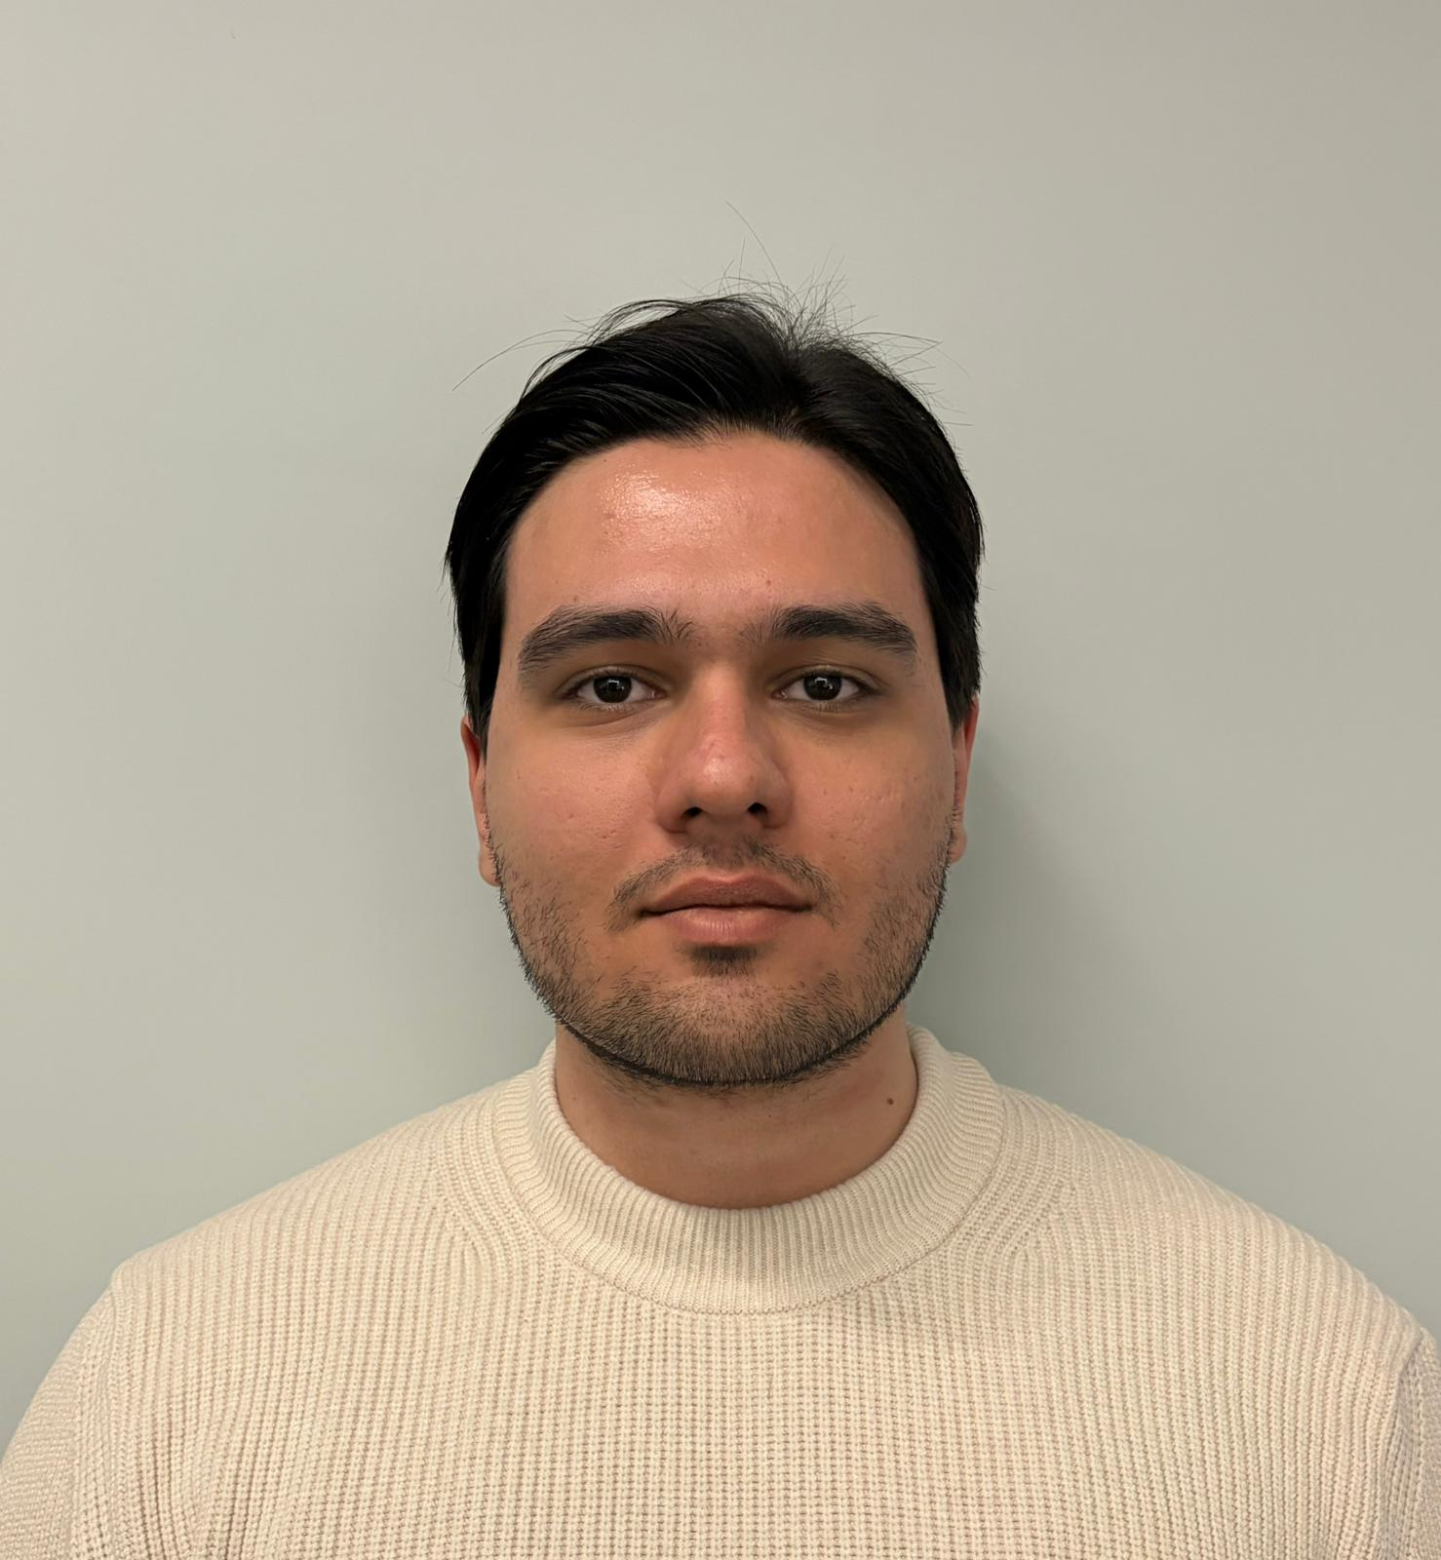
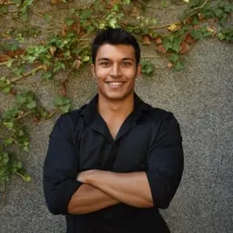
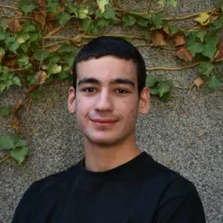
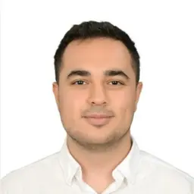
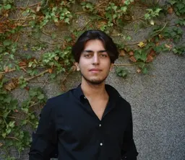
13 · THANK YOU
Thank You
Questions?
Anıl Kılıç
Aybars B. Aksoy
Barış Yaycı
Bora Yetkin
Eren Berk Eraslan
SUPERVISOR
BILKENT UNIVERSITY
Ayşegül Dündar Boral
CS 491 / 492 · Spring 2026
13 / 13 PARSE

